Slide 1

APPLIED DATA SCIENCE PORTFOLIO
Satwik Belaldavar
SU ID: 429747172
SPRING 2024

Slide 2
Introduction
1
2
The Applied Data Science program at Syracuse University equips students with the essential competencies required to excel as data professionals adept at resolving issues through data analysis. The program focuses on:
Gathering, transforming, and storing data effectively.
Mastering data visualization techniques to identify trends, patterns, and to effectively communicate insights.
Applying both supervised and unsupervised machine learning methods to comprehend data and forecast outcomes.
Presenting analytical results in a manner that is accessible to audiences with diverse levels of technical expertise.
Formulating actionable recommendations based on data analysis for businesses, organizations, management, or shareholders.
3
4
5
6
7
8
9
10
11
12
13

Slide 3
Introduction(cont)
1
2
The following projects demonstrate the skills I have learned in various classes of my program:
IST 687 Introduction to Data Science
IST 718 Big Data Analytics
IST 722 Data Warehouse
3
4
5
6
7
8
9
10
11
12
13

Slide 4
1
IST 687 Introduction to Data Science
2
3
Goal: Analyze healthcare cost data to identify and predict high-cost individuals, providing the Health Management Organization with actionable insights and recommendations to reduce healthcare expenses.
Software used: Rstudio.
About the data: The dataset for this project contains healthcare cost information from an HMO, where each row represents an individual. It encompasses variables such as age, location, lifestyle factors like exercise and smoking habits, BMI, medical history, and the total healthcare costs for the year. This comprehensive data set allows for an in-depth analysis of the factors influencing healthcare expenses.
4
5
6
7
8
9
10
11
12
13

Slide 5
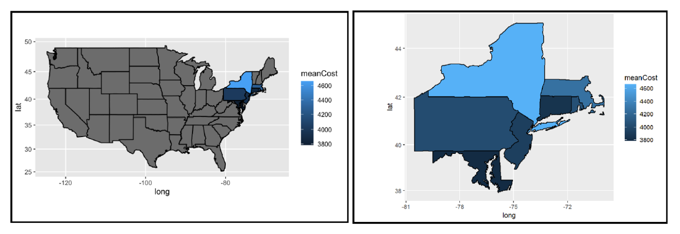
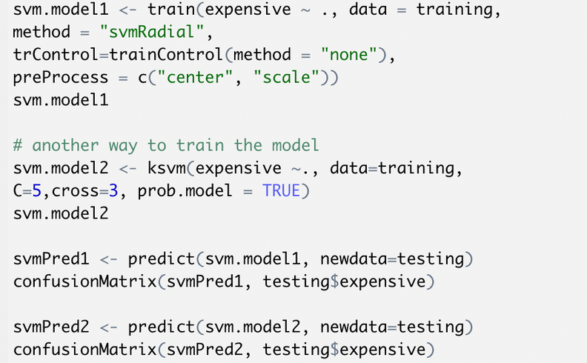
Visualizing the data
1
2
3
4
5
6
7
8
9
Create and test model
10
11
12
13

Slide 6
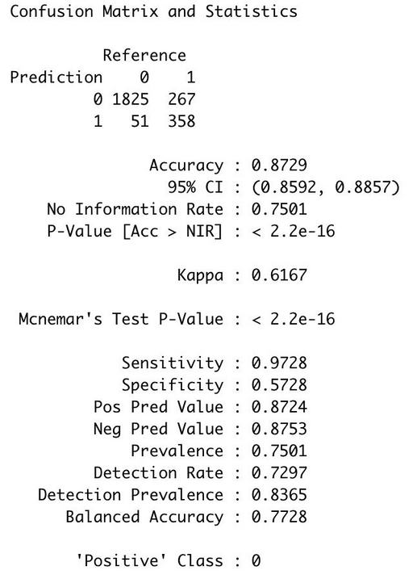
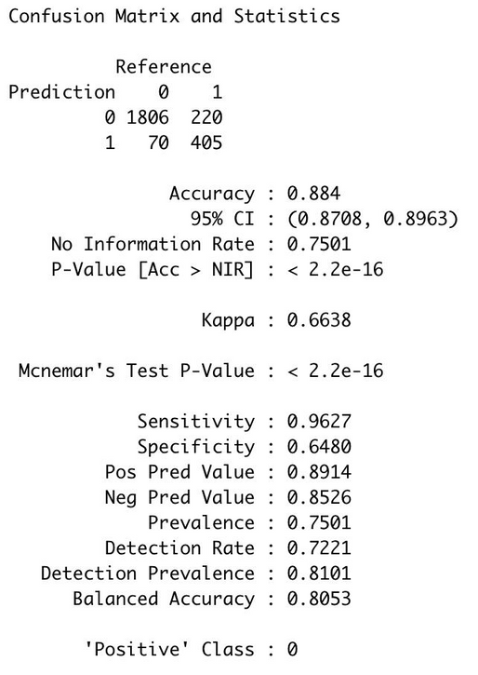
Results:
1
2
Conclusion:
Upon visualizing the initial data, we developed a multiple linear regression model incorporating all available variables to estimate healthcare costs. The analysis revealed that factors such as age, BMI, number of children, smoking status, and residency in New York significantly contribute to increased insurance costs at a 0.05 significance level. An uptick in any of these variables was associated with a rise in costs, with smoking and New York residency being particularly impactful. Consequently, a refined model was constructed with only these significant predictors, leading to a more streamlined analysis of cost drivers.
3
4
5
6
7
8
9
Skills learned from this project:
• Loaded, cleansed, and prepped the dataset for comprehensive analysis.
• Developed insightful visual representations from the dataset to identify key patterns.
• Trained and evaluated Linear and SVM models, assessing the influence of different variables.
• Formulated strategic recommendations based on the outcomes of the data analysis.
10
11
12
13

Slide 7
1
IST 718 Big Data Analytics
2
3
Goal: To develop a model to predict and analyze customer churn in the telecom sector, aiming to enhance retention strategies by identifying customers at high risk of contract cancellation. The initiative is designed to enable targeted retention campaigns, offering special incentives to those identified customers to reduce churn rates and understand the underlying reasons for their potential departure.
Software used: Anaconda Jupyter Notebook
About the data: The dataset, sourced from the Teradata Center for Customer Relationship Management at Duke University, focuses on customer churn within the telecom sector. It includes 51,047 entries and 58 attributes, detailing various aspects such as customer satisfaction, behavior, and profitability. This comprehensive dataset provides a foundation for analyzing and predicting customer churn, enabling analysts to identify potential churners and understand the factors contributing to their decision to switch service providers.
4
5
6
7
8
9
10
11
12
13

Slide 8
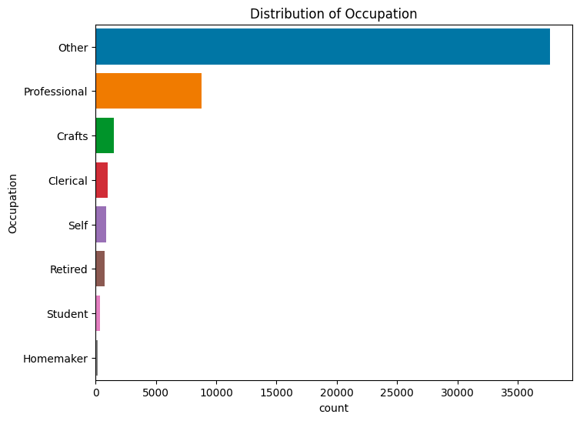
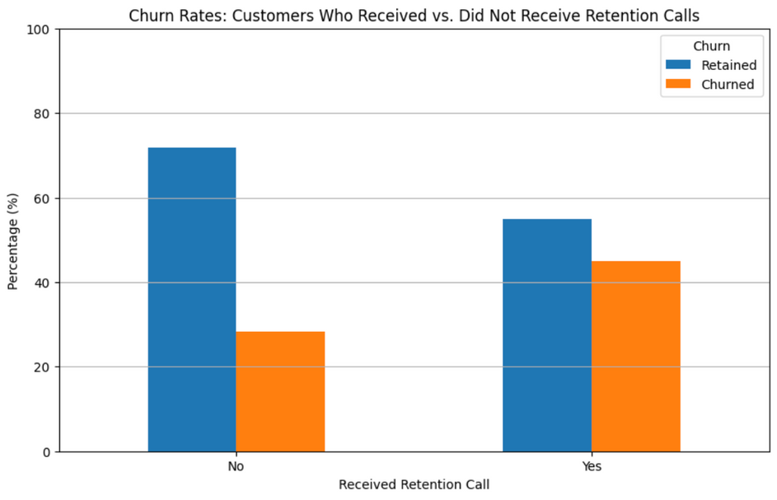
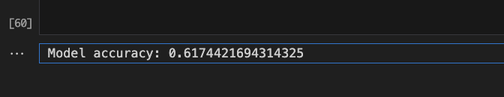
Visualizing the data
1
2
3
4
5
6
7
8
Predictions and results:
9
10
11
1. Customer Churn Prediction
Model: Random Forest Classifier
12
13

Slide 9

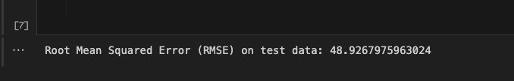
1
2
2. Customer Churn Prediction
Model: Random Forest Classifier
3
4
5
3. Customer Churn Prediction
Model: Random Forest Classifier
6
7
8
Conclusion:
Our project achieved its prediction and inference goals with moderate success. The churn
prediction model, using a Random Forest Classifier, attained a 61.74% accuracy, suggesting a
foundation for targeted retention actions but also highlighting room for optimization. Revenue
forecasting with a Random Forest Regressor yielded an RMSE of 6.80, indicating a reasonable
prediction accuracy, while overage minutes prediction achieved an RMSE of 48.92%, pointing to
further opportunities for model tuning. These results show a good starting point for practical
applications and future enhancements in churn prediction and revenue forecasting within the
telecom industry.
9
10
11
12
13

Slide 10
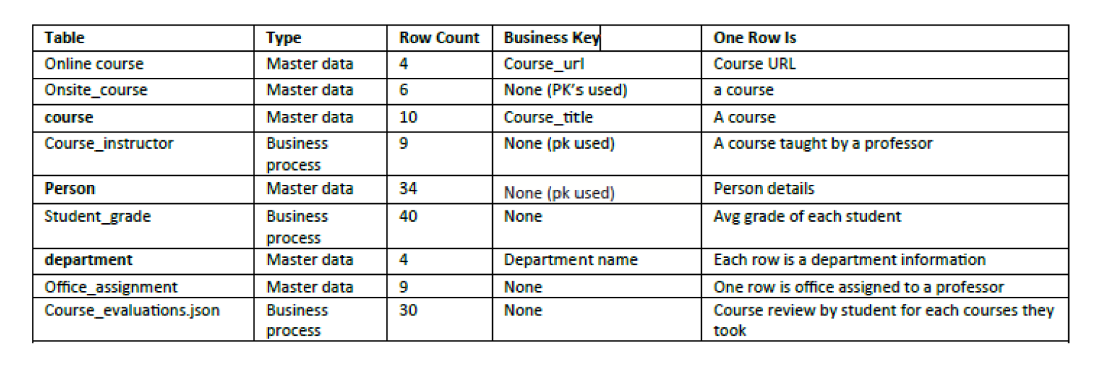
1
IST 722 Data Warehouse
2
3
Goal: Our project aimed to gain a deep insight into university operations through a data-driven approach. We explored online and offline courses, profiles of instructors and students, departmental structures, and external data from S3 containing course ratings and reviews. Choosing Snowflake as our data warehousing platform, we laid the foundation for a modern data management system.
Software Used: Snowflake, dbt, Azure Data Studio, Power BI
4
5
6
7
8
Data Profiling:
9
10
11
12
13

Slide 11
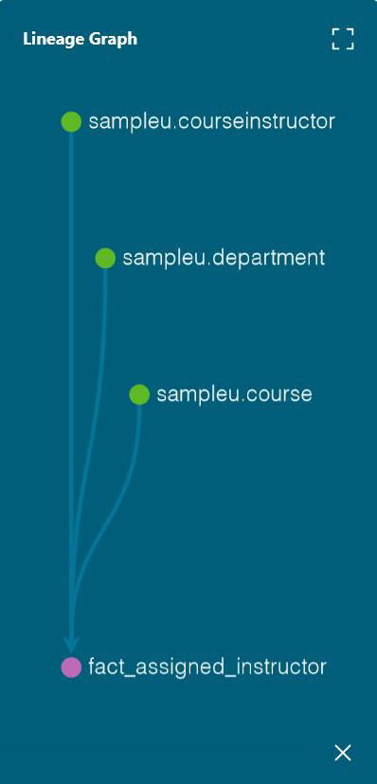
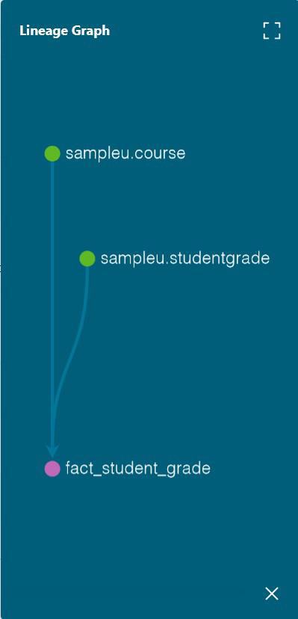
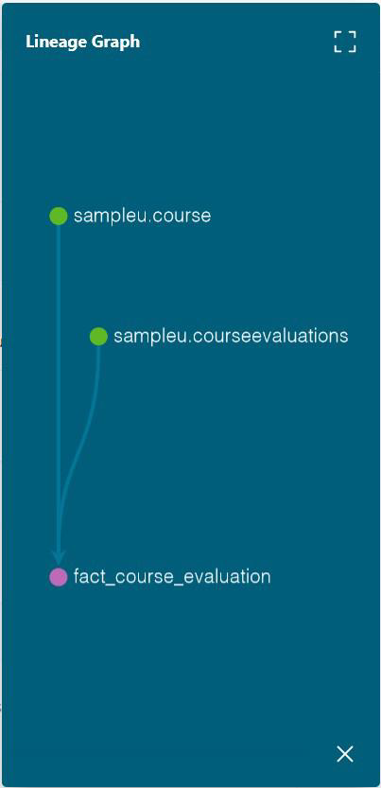
Transformation and Analytics
1
2
3
4
5
6
7
8
9
10
11
12
13

Slide 12
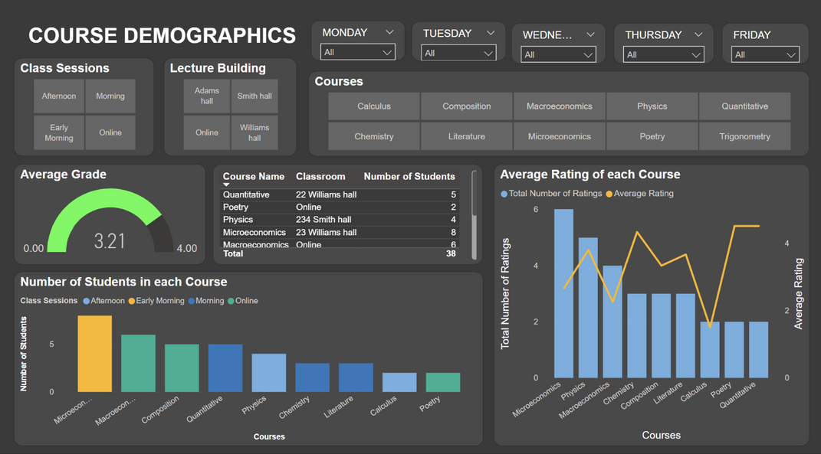
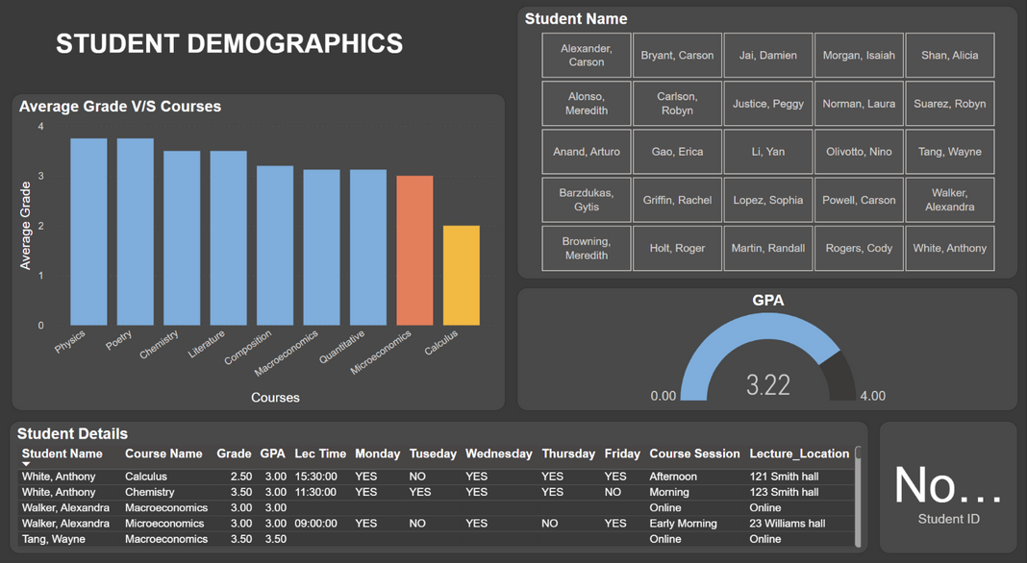
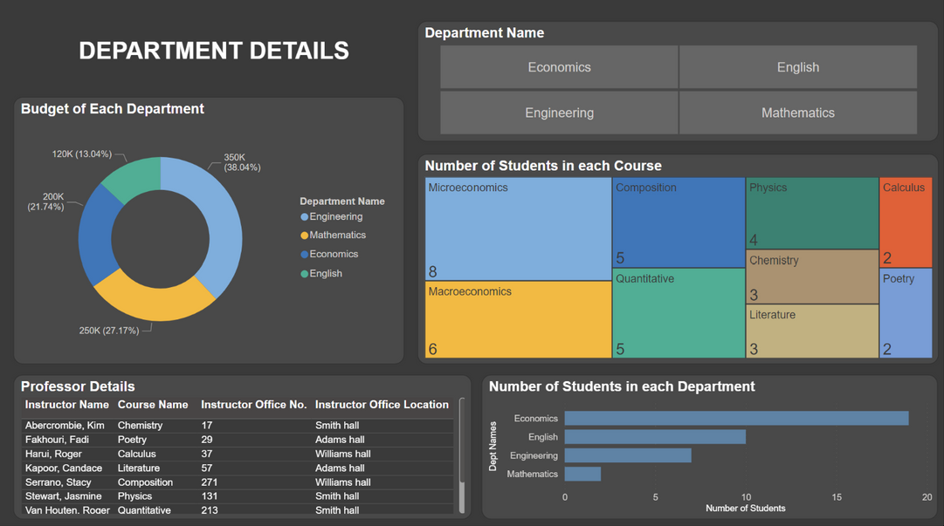
Visualization and Analysis
1
2
3
4
5
6
6
8
Conclusion:
By combining Snowflake, dbt, and Power BI, our project converged technological tools, providing a holistic understanding of university dynamics. We learned fundamentals behind data warehousing and with this project we were able to create a complete data warehouse workflow. Visualizations acted as windows into course scheduling and student performance, offering actionable insights. This project serves as a foundational platform for ongoing enhancements and advanced analytics, contributing significantly to informed decision-making within the university.
9
10
11
12
13

Slide 13
1
Reflection on the Program
2
3
Throughout my studies in this program, I developed the skills to extract insights from data and provide recommendations to businesses using visualizations, statistical analysis, machine learning, and other analytical techniques. I am grateful to all my professors, classmates, and advisors for their guidance and support, which has equipped me for a successful career in data science.
4
5
6
7
8
9
10
11
12
13

Slide 14
1
2
3
4
5
6
THANK YOU
7
8
9
10
11
12
13

